Slide 1
Scratch
Your way into a new approach to coding. Create projects faster than ever before
By: Carissa Wong

Slide 2
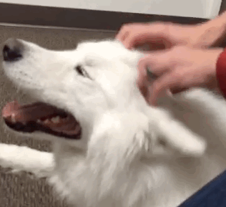
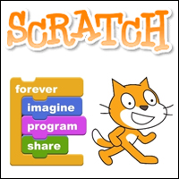
No, not a Head scratch!
Scratch the project!
“With Scratch, you can program your own interactive stories, games, and animations – and share your creations with others in the online community.”
Notes:
Scratch is a project of the Lifelong Kindergarten Group at the MIT Media Lab.
Scratch helps kids and adolescents learn to think creatively, reason systematically, and work collaboratively
Although it is designed for 8-16 years olds, it’s great for all ages! Buuuuut, younger children may need help from their parents
More than 7500 educators across the Globe are using ScratchEd!
ScratchEd is an online community launched almost 6 years ago for Scratch educators to share stories, exchange resources, ask questions, and find people.
It’s an educator’s dream, a free, fun project with endless uses!

Slide 3
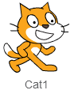
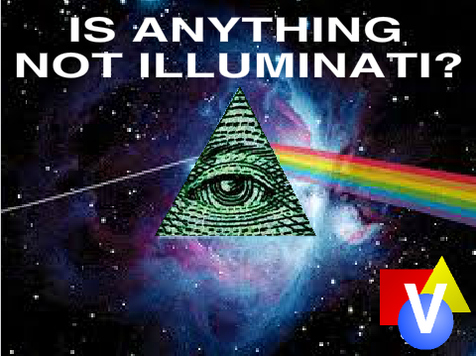

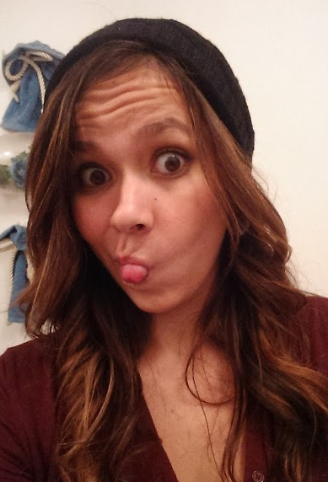

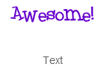

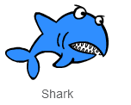
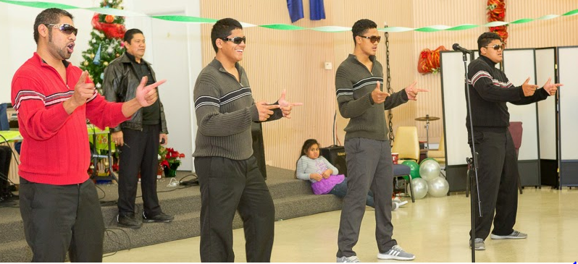
Start with a Sprite! (A Scratch Sprite, not a soda sprite. Although, a Soda Sprite picture can be a scratch sprite!)
Notes:
You can start with a character, known as Sprites. There are dozens to chose from or you can paint your own. Another option is to simply upload existing pictures or take a new one with your webcam!
Sprites also don’t have to be characters. They can simply be an image that you want to display at a certain time as well as have different things happen while it’s there.
Sprites are fully customizable with the use of Costumes. Costumes often are the same Sprite in a different position or in different colors and clothing.
Once again there are many preloaded or you can create your own much the same way as you created a Sprite.
My personal favorite is to find a GIF I want to use as a Sprite and capture a few different points within it to use as that Sprite’s costumes

Slide 4
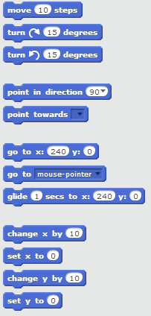
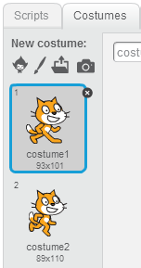
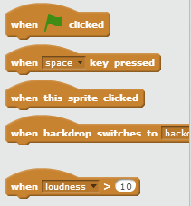
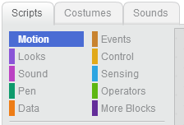
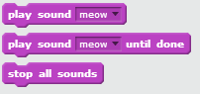
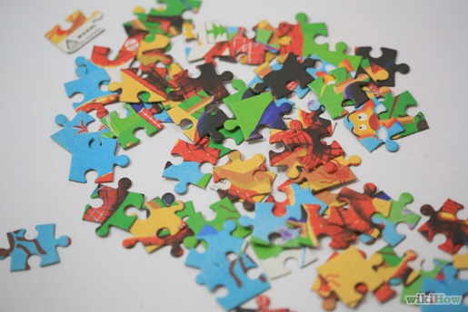
No actual typing your own code!
Unless you feel the need to create your own actions that is
Notes:
With Scratch, you don’t need to write any code if you don’t want to. The code is already there as puzzle pieces for you to put together. Simply drag and drop!
Sounds too easy to be true? Nope. That’s Scratch.
Once you have a Sprite on your page it’s time to do something with it. Once you’ve selected your Sprite:
There are Scripts with code pieces to effect the motions, looks, sounds, events, and controls.
There are also scripts for the pen, data, sensing, operators, and creating more blocks of code.
You can add or create as many Sprites in your project as you like! When controlling a particular Sprite all you have to do is click on his icon in the Sprites menu then create your script.

Slide 5
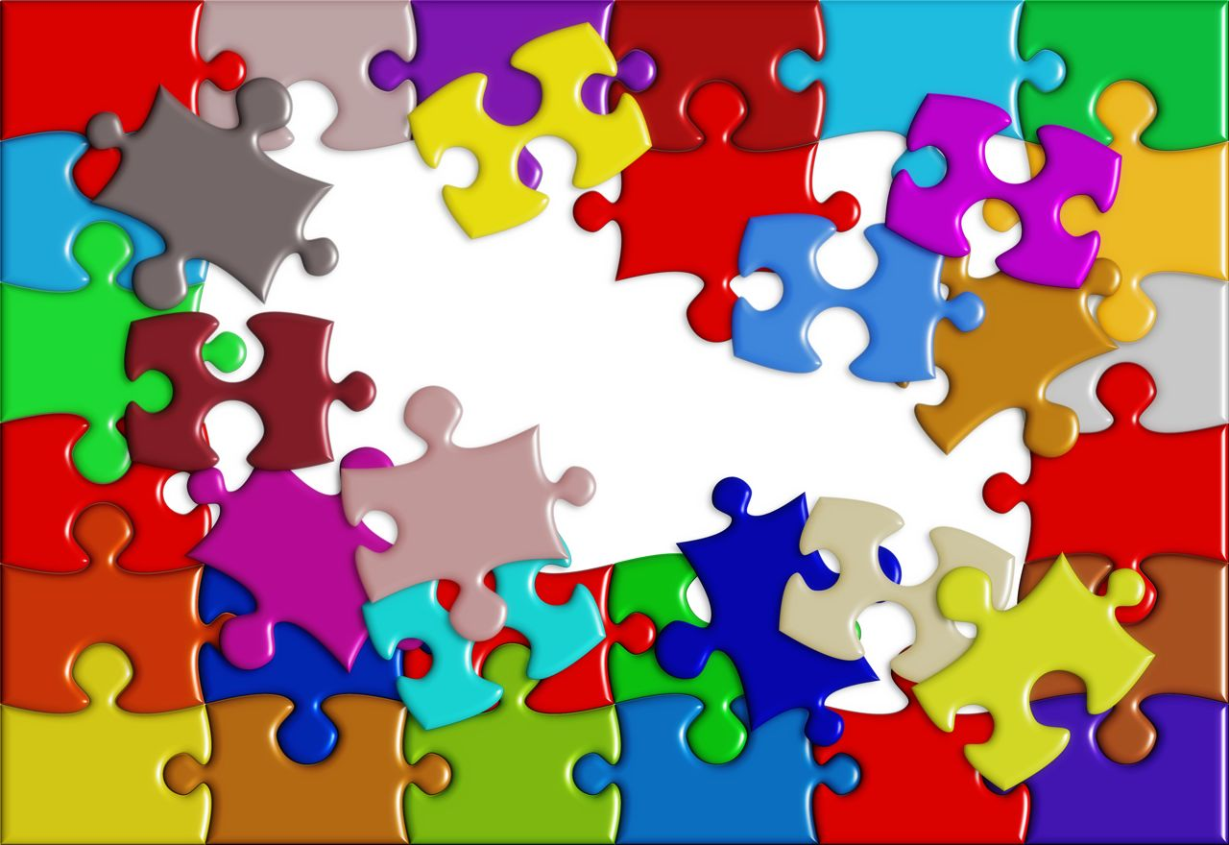
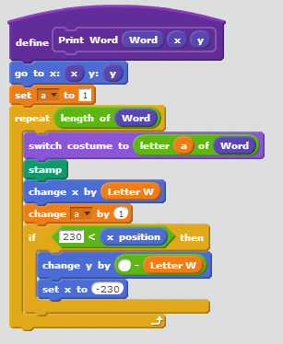
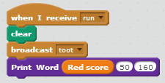
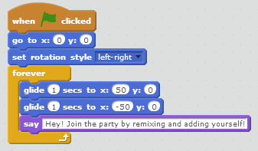
Connect the puzzle pieces
Drag and Drop.
Edit Numbers.
Edit Text.
Notes:
Time to connect those handy pre-coded Scratch puzzle pieces to use in the script
One Sprite can have multiple sets of commands at once.
For instance let’s say when the green flag gets clicked we want our Sprite to move back and forth across the page, we can do that!
But we also want him to make a noise every time he hits a specific spot on the page, we can do that too!
Alright, but we want our Sprite to also look like he’s moving so as he goes back and forth across the page we want to him to alternate costumes. Just another bit of the puzzle!
Along with one Sprite having multiple sets of commands, multiple sprites can be doing something at the same time! While Sprite 1 moves back and forth Sprite two can stand in the corner and talk!
Once again, endless possibilities!
Be sure to write instructions for your project as well as any notes and credits to make it that much better!

Slide 6
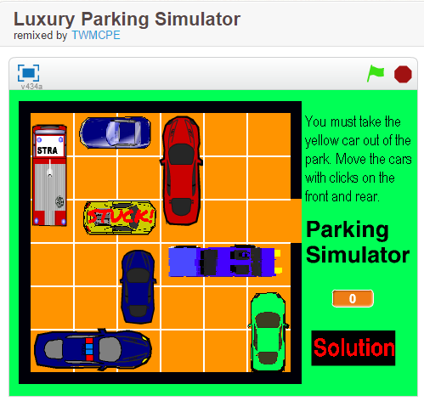
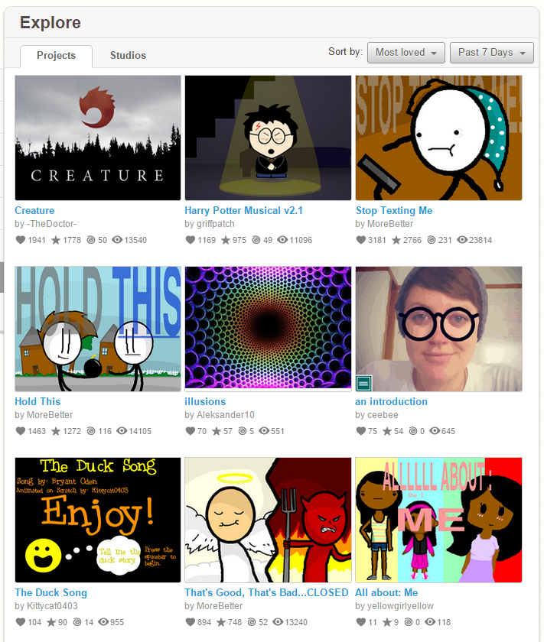
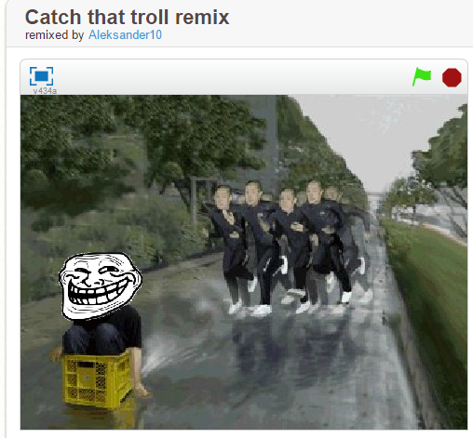
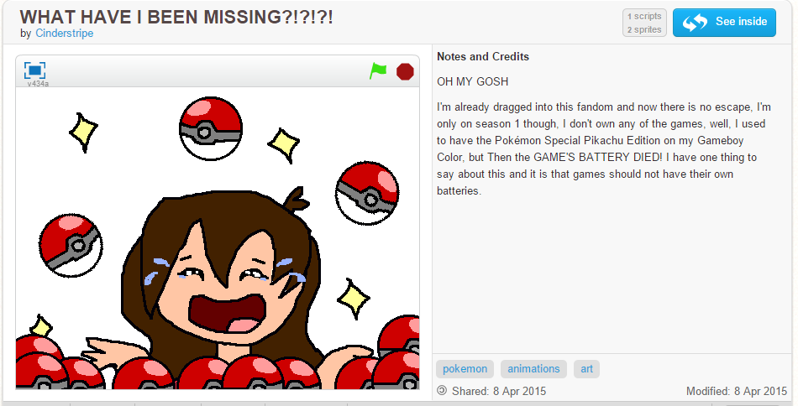
Explore! There’s so many possibilities, check out what others have done.
Music
Stories
Art
Animations
Games
Featured
Notes:
Okay so you’ve got the basics down, but you want to make a more complicated project. Easy, that’s what the community is for!
Simply Explore Scratch!
Clicking the explore tab will bring you to existing projects. Featured ones are always fun to check out but if you know what you’re looking for you can search tags or by subject.
You can do a lot more with Scratch then you’re probably thinking.
Once you open a project along with seeing what it does you can “See Inside” of it too. This brings you to the backend of where the creator put together the puzzle pieces.
If just seeing examples is enough, great, use it in your own projects.
But!

Slide 7
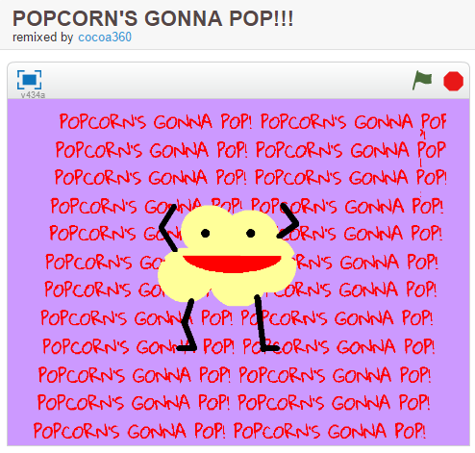
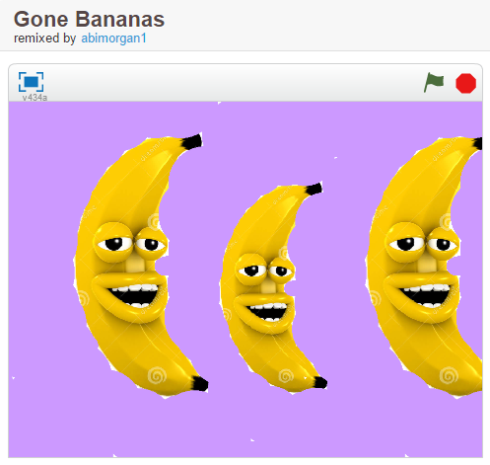
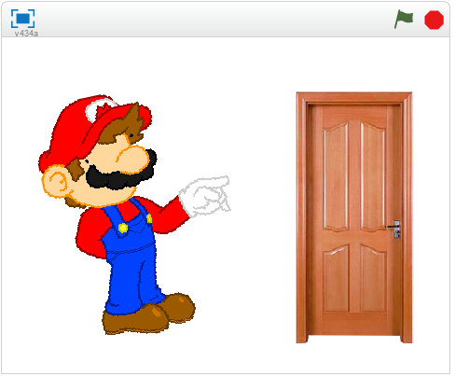
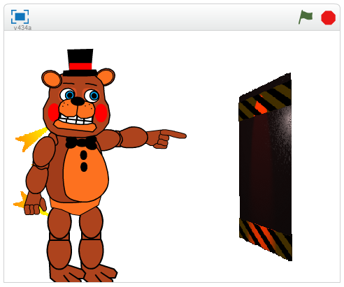
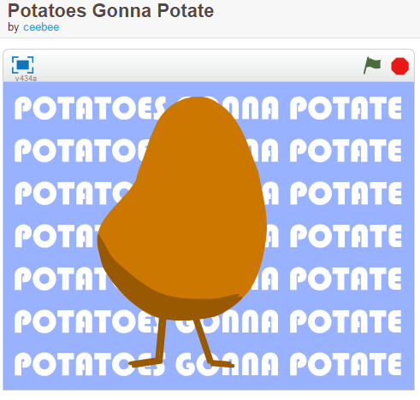
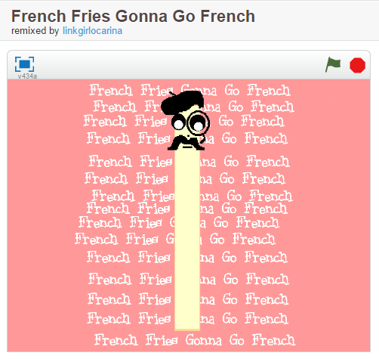
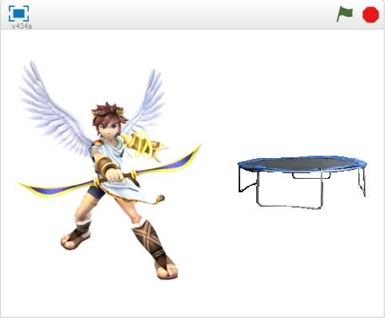
Re-Re-Re REMIX!!
Mario’s Opinion on Doors
Toy Freddy’s Opinion on Doors
Pit’s Opinion on Doors
Notes:
- If you really like the project you can always remix it, as in take the framework of it but change it up, make it your own!
Sometimes users create projects purely for the purpose of challenging the Scratch community to be creative and remix the project into something new. There’s even contents all the time.
Most often remixes are slight changes whether it be changing the Sprite, changing the colors, or changing the words.
However, there are more complex remixes as well.
That’s when we get into the Scratch’s Studios instead of just the projects. Studios are meant to keep projects within a particular theme

Slide 8
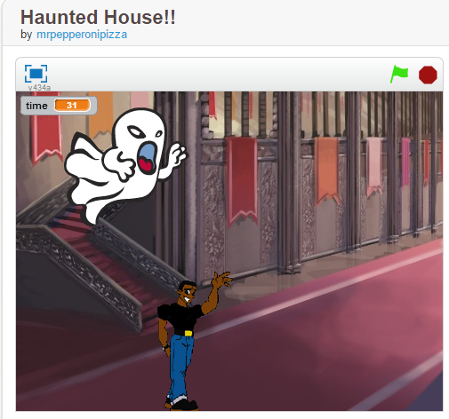
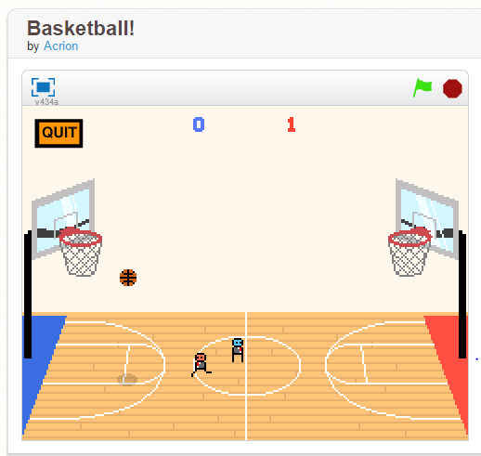
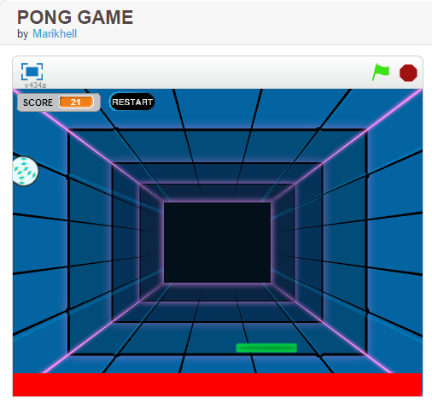
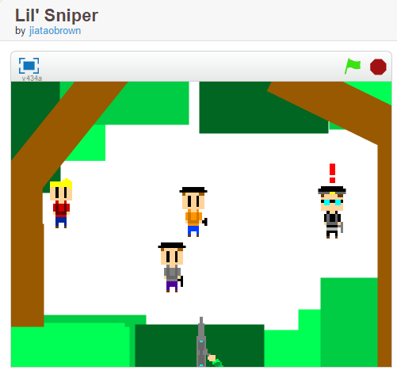
A Few scratch game possibilities
Notes:
Hoping back just a little, did you catch the games part of the endless possibilities of Scratch I mentioned earlier? Yupp. That’s right, you can create games using Sketch, and not just simple move up, down, left, and right to complete a maze or something like that.
You can create a game of Pong! OR Snake! OR arcade style shooting games! You can even create a two player basketball game!
- Obviously the more complex the game, the harder it is to make, but trust, me, it’s not as hard as you might think. Remember, Scratch was designed with a younger audience in mind.
- There area also Tutorial projects within Scratch that help you design games. They start you off simple with making a Sprite dance then get more complex into some sort of competition with the computer or another player.

Slide 9
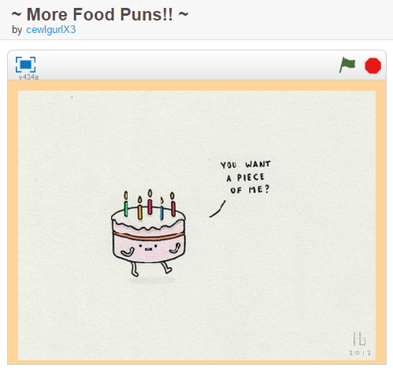
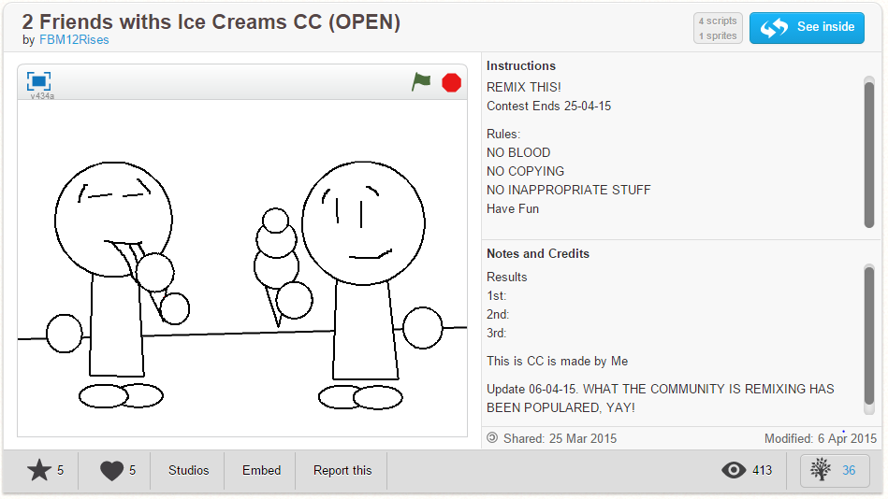
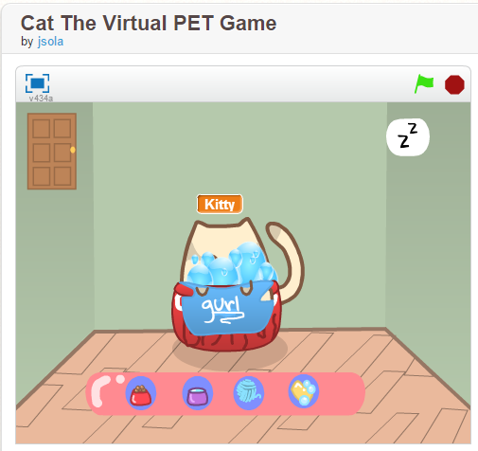
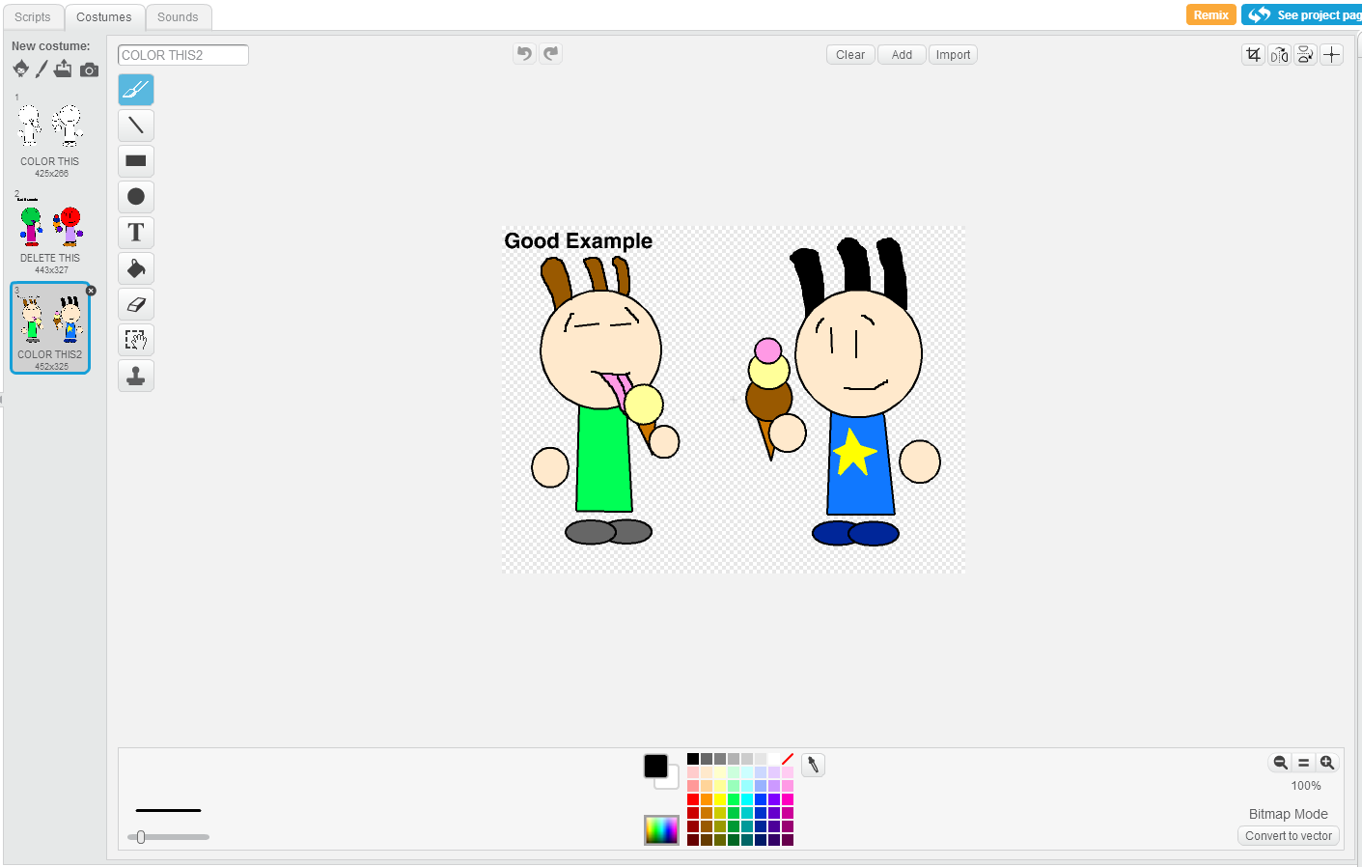
Sweet and Simple for the Youngin’s
Notes:
As I mentioned earlier, Scratch is designed with pre-coded puzzle pieces to use in the script.
This makes it much easier for the little ones to get the hang of Scratch. Common projects for kids are pre-made games that they can play, Coloring remix challenges that require a little more use of Scratches features, or just simple flip books with jokes for kids to easily create with images enjoy others.

Slide 10
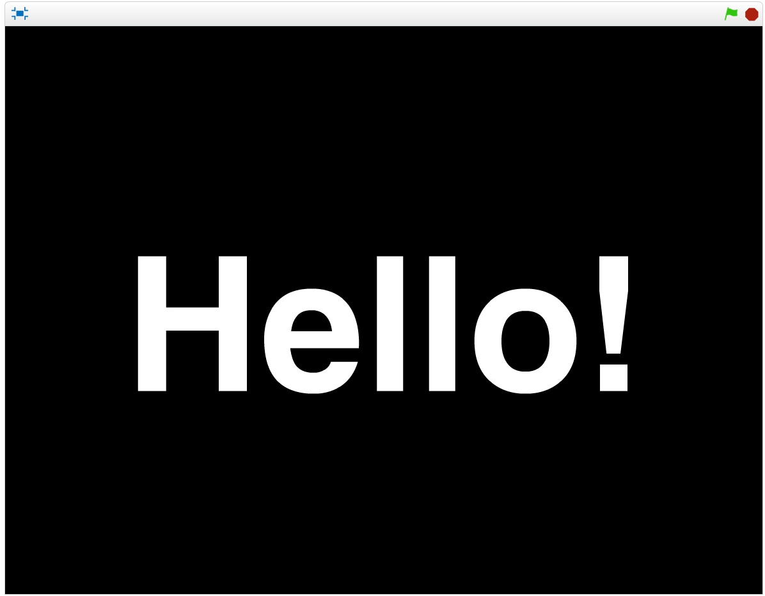
The more advanced users can do a bit more with scratch – such as stories with multiple features
Notes:
Scratch is designed with pre-coded puzzle pieces to use in the script

Slide 11
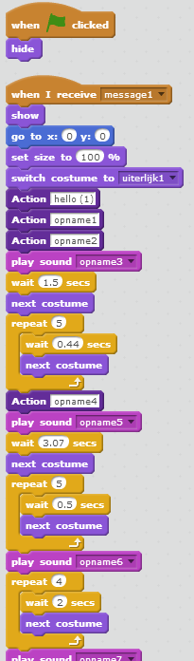
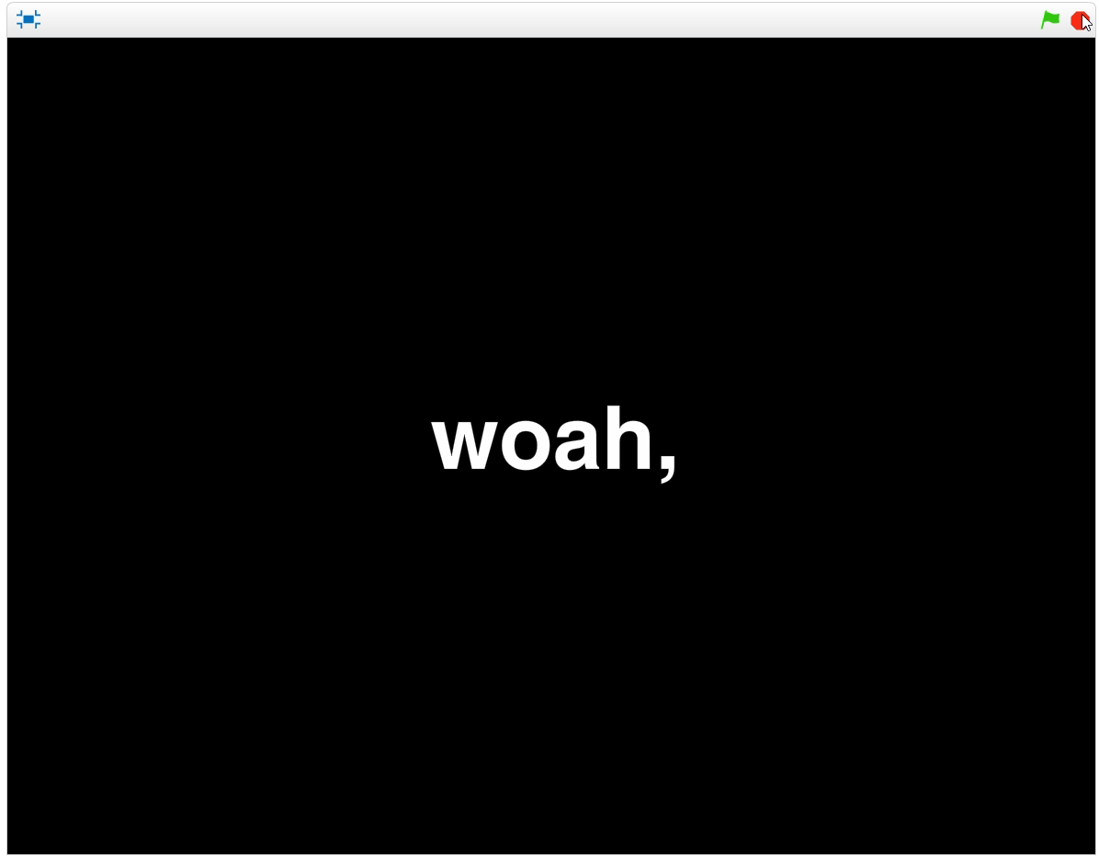
Notes:
Scratch is designed with pre-coded puzzle pieces to use in the script

Slide 12
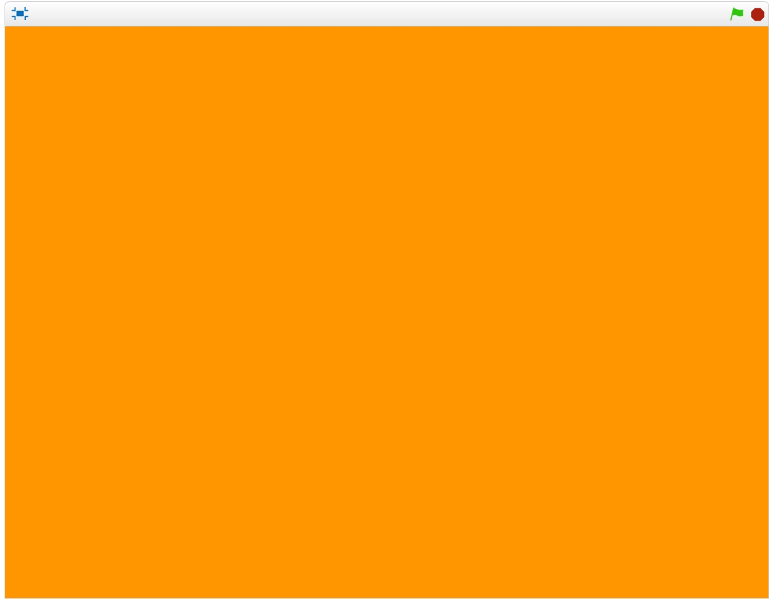
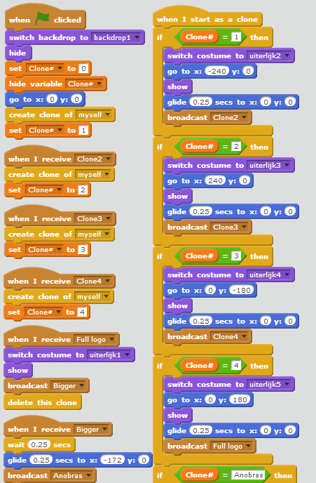
Notes:
Scratch is designed with pre-coded puzzle pieces to use in the script

Slide 13
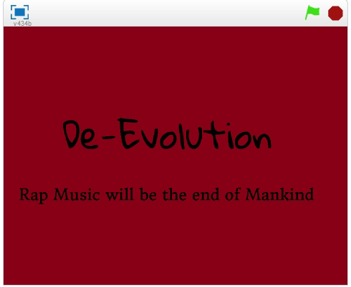
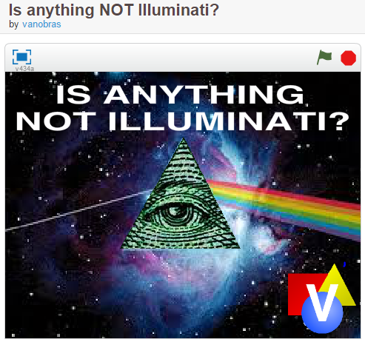
My Example
Notes:
-
- Another great thing about Scratch for people like me, us scatterbrained people can easily jump around within our project. Well that is unless you’re having issues with the ever so wonderful Flash Player.. Any who, where I was going with that is I mentioned remixes earlier and some of the different possibilities with those. One of my new found favorites to do in Scratch is to Remix the Illuminati everywhere project but with my own “Out-There but semi logical conspiracies”.

Slide 14
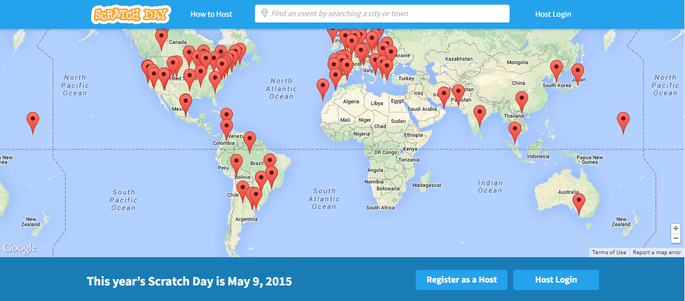
Other Features of Scratch
Multiple ways to Get Started: Step-by-Step Tutorials, Starter projects, videos, etc.
Video Update Episodes from the creators
Various Forums that are consistently updated
Scratch Curriculum Guide: An Introductory computing course using Scratch
Translated into almost a dozen languages
Many Resources
Focus on Creative Computing
Events that reach across the globe
News on Scratch @MIT Conference
Notes:
Scratch around the world
As I mentioned before Scratch has an online community refered to as ScratchEd. Along with this resource Scratch also has a Wiki, an Offline Editor, Statistics on Scratch and it’s community, and also a way to connect your Scratch projects to the physical world with MaKey MaKey, LEGO WeDo, or PicoBoard
Two of the more popular forums are “Things I’m Making and Creating” and “Things I’m Reading and Playing”
This connects you with the community on a collaborative, creative way as well as gives you a chance to talk about the things that inspire you and your projects
There is a “Scratch Day” which is May 9th this year. It is a gloal network of events that celebrates Scratch and the young people who code and create with it.

Slide 15
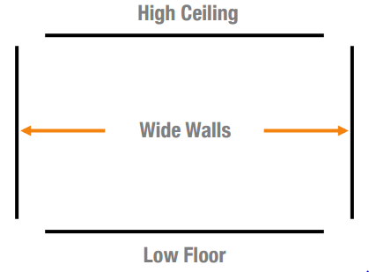
Still have questions?
“Low Floor, High Ceiling, and Wide walls”
What is good Scratch?
“Scratch is not just a tool, it represents an approach to learning.”
What is Scratch good for?
Computational thinking, concepts, practices, and perspectives.
Low Floor: easy to climb in and get started
Wide Walls: can make all kinds of things, open to the imagination
High Ceiling: can still make complex projects
Notes:
- A common question asked about Scratch after the initial what is it, is What is good Scratch?
Scratch is a Design-Based Learning approach, not just a tool.
- Learning through design
- the idea that kids don’t just get ideas, they make them and learning to do this while actively involved increases the benefits
- Learning through interests
- Learning through collaboration
- Creativity can be a social process, especially at a young age.
- Learning through reflection
- identify what we know vs what we need to know
Another Question that often comes up about Scratch is what is it good for?
Computational thinking
Computational Concepts
i.e. sequences, loops, events, lists, variables, operators, and conditionals
Computational Practices
i.e. incremental/iterative, testing/debugging, reuse/remix, abstraction/modularization
Computational Perspectives
Expressing, connecting, and understanding
- The goal of Scratch is to increase K-12 students sense of ability to take effective control of their lives both now and in the future.
- One of the huge benefits of Scratch is that is being used globally. The Diverse users make for a more well rounded community as everyone’s culture effects them in school, responsibilities at different ages, and in their out of school lives.

Slide 16
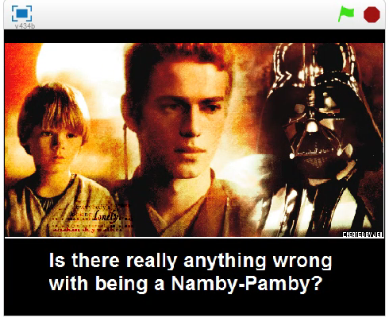
Are middle aged men living in their mom’s basement really a problem?
Notes:
Scratch is designed with pre-coded puzzle pieces to use in the script

Slide 17
Coming soon: A new Scratch Studio! “Conspiracy theories supported with irrefutable evidence”
Yogi Bear has never liked picnic baskets
Netflix will change the Earth’s climate
Billiard Pool Players will wipe out America’s goat population
Too many users cause a worldwide blackout
Scientists try to find new energy sources to prevent a permanent blackout
Try to harvest energy from the Sun, end up causing it to go Supernova
Climate changes, plants die, Armageddon
Jesus and Big Foot are one in the same
Jesus disguised himself as the Easter Bunny to be present at own resurrection celebrations
Did this too many times, got stuck in an in-between state
Became mix of animal, man and god → Big Foot
Allergic to bamboo
Preferred a pot, but since he was not Winne the Pooh the Ranger stole Yogi’s pot and kept it for himself
Yogi had to resort to taking picnic baskets hoping for goodies
The Ranger talked to and stole from a bear.. Do you really think it was over a pot and not pot?
Shooting pool requires concentration, both eyes open, ability to line up a shot, and stay calm under pressure
Pool players will become the best shots in the nation
Pool players drink a lot of beer, goats keep eating the barley
Pool players will shoot all the goats to help beer production
Fictional/Folk Lore characters are actually people from the Bible
Chupacabra, aliens, loch ness monster, jersey devil, moth man

Slide 18
Sources
Information
Images
Sketch.mit.edu
http://scratched.gse.Harvard.edu/sites/default/files/fourquestionsaboutscratch.pdf
http://www.fromtexttospeech.com/
http://scratched.gse.harvard.edu/
Sketch Community
Vanobras
Acrion
Binnydakalme
FlamestrikerX
ScratchU8
Ceebe
www.tublr.com/search/baby%20samoyed
www.vendopedia.com/index.php?title=File:Puzzle.pieces.partly.complete.jpg
Photobucket.com/images/head%20scratch
Google.com – image search
Anakin Skywalker Darth Vader
Momma’s Boy

Slide 19
Sources
Videos
Music
https://scratch.mit.edu/projects/54123998/
https://scratch.mit.edu/projects/56134698/
https://scratch.mit.edu/projects/56214638/
2 Chainz – I’m Different
Major Lazer – Bubble Butt
Sage the Gemini Ft. Iamsu – Gas Pedal
Master P – Make ‘em say UGH
Flo Rida – Goin Down for Real
O.T. Genasis – CoCo
Wah wah wah sound effect : https://www.youtube.com/watch?v=V8XTpCwicwE

